Slide 1
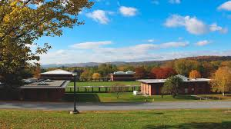
A Self-Advocacy Model
Understanding Complex Barriers to Learning among Diverse Learners
2024 Professional Visit Day at Landmark College
Rebecca Whittaker Matte, Associate Professor of Education
Dylan Sullivan, Life Science Major and S-STEM Scholar

Slide 2

Ambitions of our Kick-off Talk
Identify a primary challenges addressed by our program
Share a framework used for assessing and addressing the challenges
Discuss activities used to promote self-awareness and self-advocacy
Broaden your lens and inspire
Let’s Go!

Slide 3
Thriving in college?
Between 3.9% of incoming college students have diagnosed learning disabilities, 7.4 % ADHD, and 0.9% Autism
- Higher Education Research Institutes 2018 CIRP Freshman Survey
In 2014 only 59% of students who have disclosed their learning disabilities complete college within six years.
Up from 27.5% in 2011
- National Longitudinal Transition Study-2
68.9% students with LDs did not disclose because they did not perceive themselves as having LD;
6.9% perceived themselves as having LD but chose not to disclose.
Notes:
Graduation statistic is up from 27.5 % in 2011

Slide 4
Understanding Our Students
Overlapping characteristics among neurodivergent profiles
Notes:
Understand, deeply, the challenges of individual student and their diagnoses.
Anxiety has become a normalized term – but believe that this is not a “get out of jail free card”
We need to re-explain discomfort is normal, the group process/experience of this key to growth
But we also believe in creating a structure to allow them to both showcase their strengths and promote their growth.
Collaborative work, task initiation, collective critical thinking, time to execute new strategies (EF, academic)

Slide 5
The self-directed learner
Assessing behaviors using the framework of The Four Domains of Learning
Addressing barriers to learning through implementation of strategies
Acquiring autonomy and self-advocacy as a life- long learner
…develops a robust understanding of the interconnectedness of influences that affect learning. More importantly, this includes the ability to move from areas of challenge toward acquiring positive attributes for success.

Slide 6

Understanding Learning in Four Domains
Motivation
Self-regulation
Social/Emotional Influences
Academic Skills
…A Framework for Assessing and Addressing Common Barriers that impact students transitioning to college, particularly those who learn differently

Slide 7
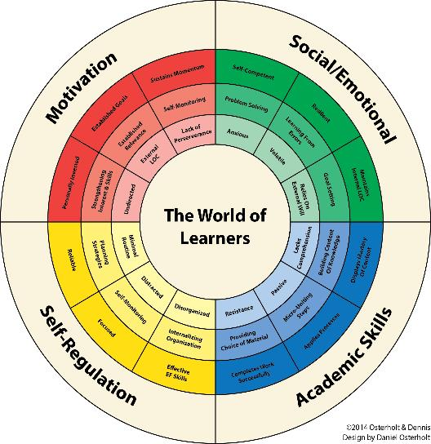
Developing Discourse
THE WORLD OF LEARNERS WHEEL
A visual model which represents specific characteristics within four domains of learning.
Barriers, applied strategies, and positive attributes are shown in relationship to one another. The goal is to establish shared language when talking about the components of learning.

Slide 8
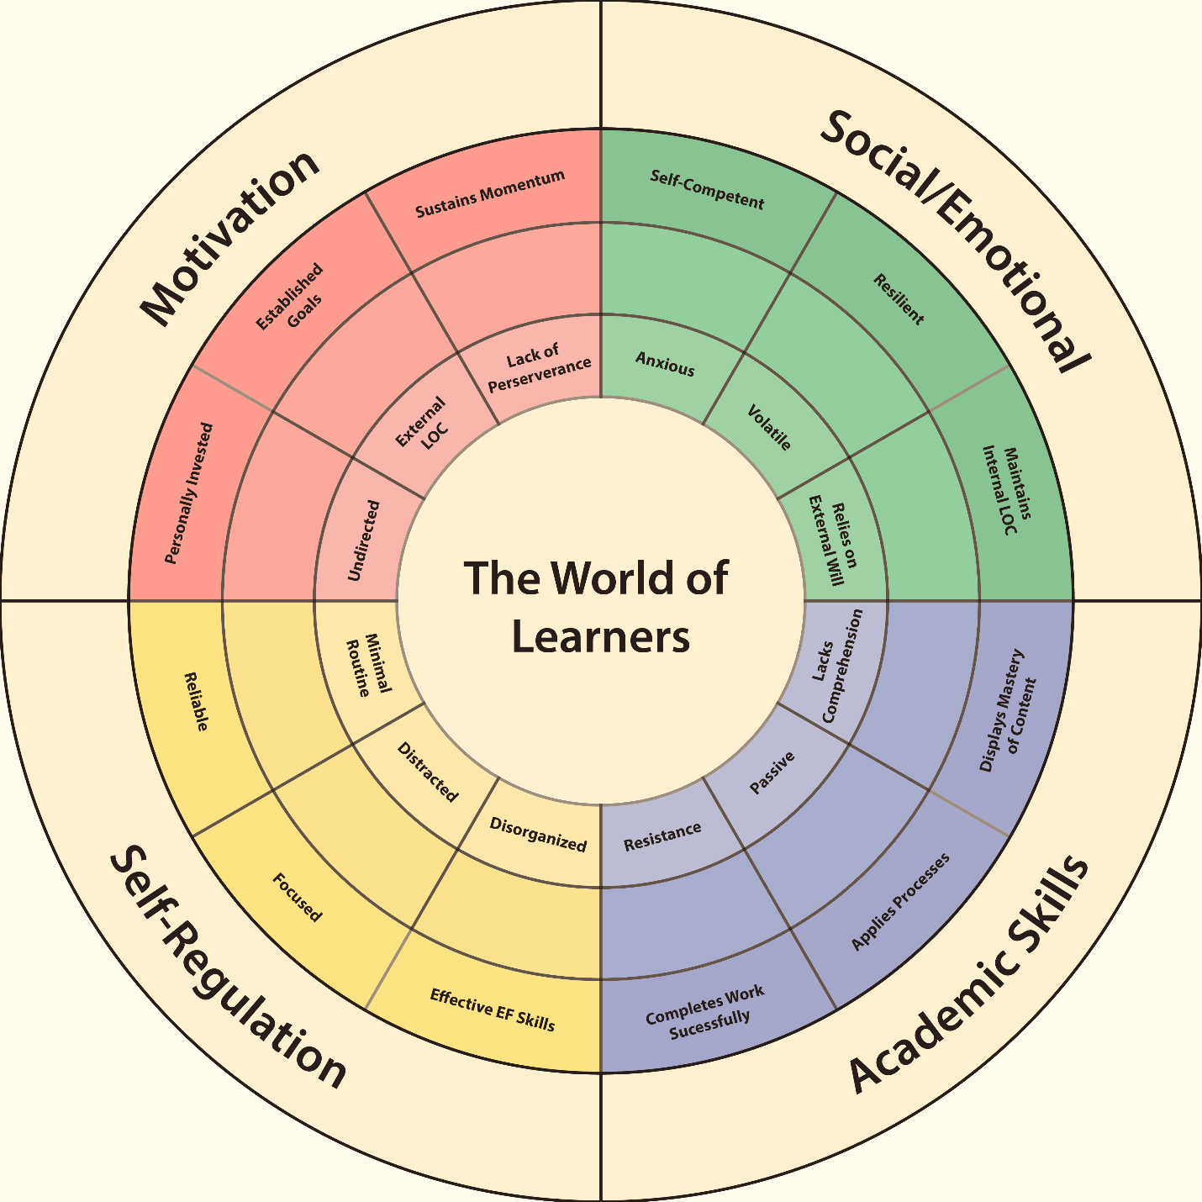
Developing Discourse
THE WORLD OF LEARNERS WHEEL
A visual model which represents specific characteristics within four domains of learning.
Barriers, applied strategies, and positive attributes are shown in relationship to one another. The goal is to establish shared language when talking about the components of learning.

Slide 9
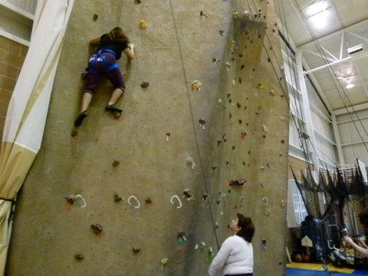
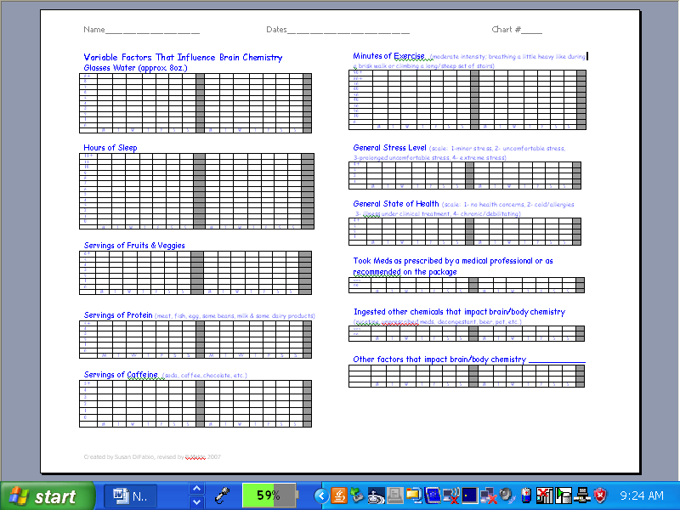
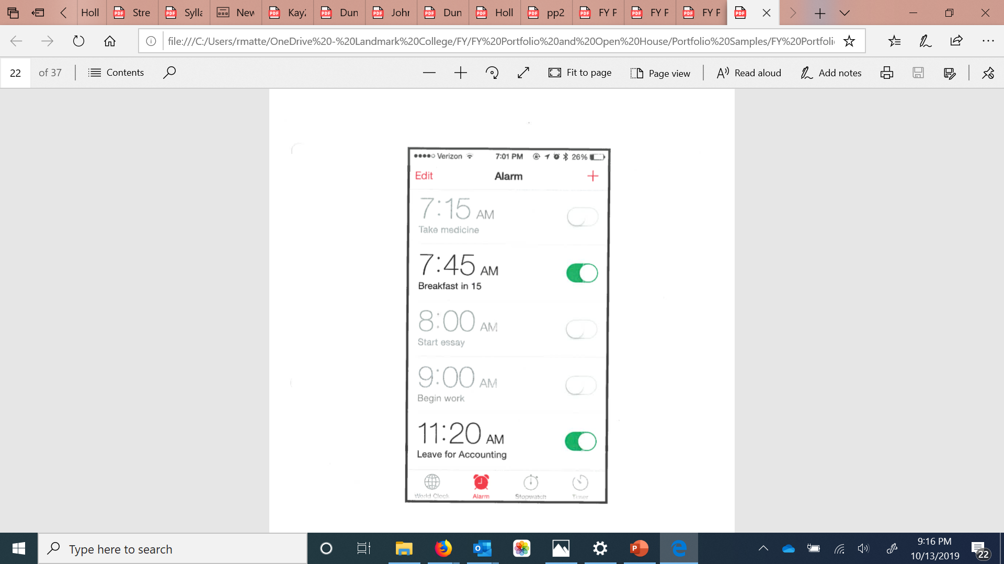
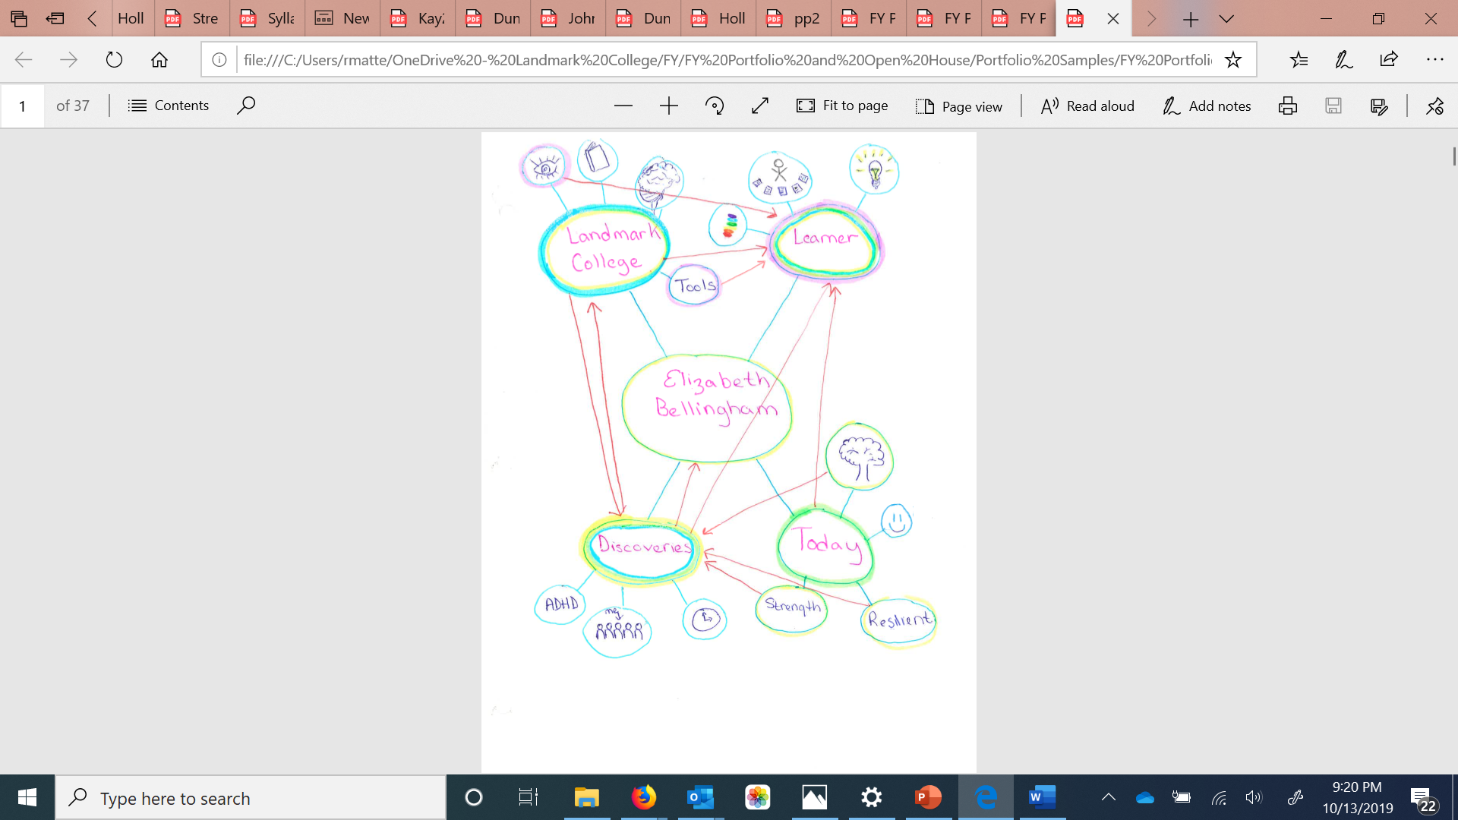
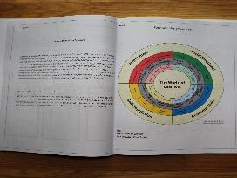
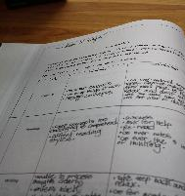
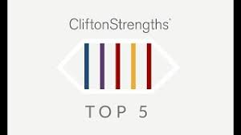
Building Self-Awareness
Exhibiting a deep understanding of factors that influence the learning process leads to self-advocacy

Slide 10


Taking Time for Self-Reflection
Reflecting on past experiences informs a better future

Slide 11
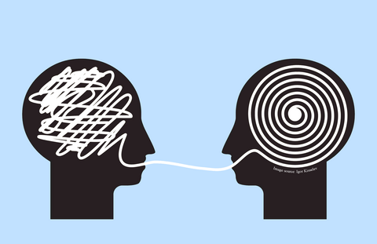
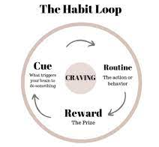
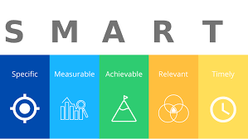
Setting Goals
Reframing changes the way we think, feel and act
Using Duhigg’s framework to create new Habits for reaching goals (with atomic support from Clear)
Identifying, prioritizing, and tracking are all part of the process

Slide 12
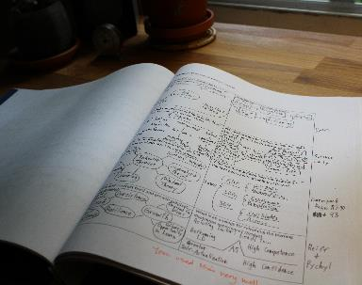
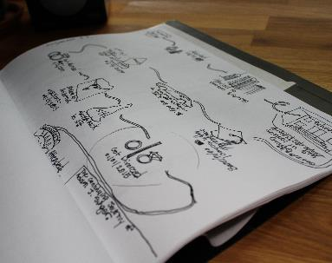
Acknowledging Positive Attributes
Selecting personal artifacts from the semester allows students to show strategies that attributed to their academic success

Slide 13

Building a Portfolio
Deepens the understanding of learning
Allows students to assess their greatest strengths and challenges
Promotes strengths
Showcases effective strategies used to address learning challenges
Clarifies possible accommodation needs to achieve
To provide an opportunity to practice self-advocacy and develop autonomy

Slide 14
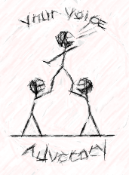
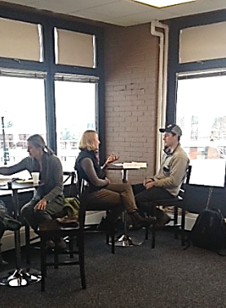
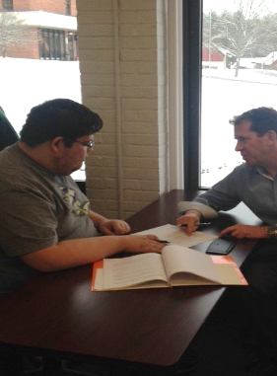
Acquiring Autonomy Through Self-advocacy
Thriving in college means accessing learning within a nurturing interdependent environment that cultivates personal investment and increases academic skills.

